Slide 1
EFB 390 Recitation
Notes:
I-NAM
Spend some time talking about the final project
Last week review – K logistic curve, inflection point, growth curve
Additive vs compensatory mortality

Slide 2
Indigenizing the
North American Model of Wildlife Conservation
Hessami et al. 2021
Identify the gaps and linkages between the NAM and Indigenous-led conservation efforts and to create the I-NAM that interweaves various Indigenous worldviews and conservation practice
Notes:
Canada

Slide 3
Why is this Important?
NAM has several shortcomings
TEK and two-eyed seeing (Tenant 6)
Holistic approach (Tenant 5)
Derived from settler colonialism
Need to be continuously learning and improving!

Slide 4
Tenant 1
NAM: Wildlife Resources Are a Public Trust
I-NAM: Wildlife are stewarded through an interwoven set of values and visions to holistically manage ecosystems. Indigenous and non-Indigenous governments are held accountable by the public to effectively do so
Removes colonial language
Encourages governments to work together and to listen to the needs of the people

Slide 5
Tenant 2
NAM: Markets for game are eliminated
I-NAM: Sustainable harvest of wildlife is paramount. Wildlife are not private entities and must be conserved for multiple user-groups, cultures, and livelihoods
Addresses there are other user groups besides hunters
Includes those who rely on wildlife for their livelihoods
Achieve a sustainable harvest
Notes:
Small yet significant number of subsistence hunters
Misplaced animal-rights activists

Slide 6
Tenant 3
NAM: Allocation of Wildlife is by Law
I-NAM: Wildlife harvest, and thereby allocation, must recognize the multiple governing bodies that have legal authority on the land
Recognizes Indigenous authority on their own lands
Kimmerer and the Honorable Harvest, “let the leaders pass”
Notes:
Honorable Harvest - to take only what is given, to use it well, to be grateful for the gift, and to reciprocate the gift
“Leaders pass” - wouldn’t shoot the caribou at the front of the herd to ensure continued migration

Slide 7
Tenant 4
NAM: Wildlife can be killed only for a legitimate purpose
I-NAM: Definitions of legitimate take must remain flexible, adhere to respective governing authority, and be centered around food security, conservation, livelihood, and cultural integrity
Ties in cultural and subsistence uses
Removes consumptive Western lens
Again acknowledges Indigenous laws
Notes:
Wildlife harvest is also associated with keeping traditions alive, intergenerational knowledge transfer, acquiring materials for utility and art, as well as building and maintaining social bonds
How do we feel about staying flexible with the “legitimate” definition?

Slide 8
Tenant 5
NAM: Wildlife is considered an international resource
I-NAM: Wildlife do not exist within fixed political boundaries. Therefore, cross-boundary collaborations between non-Indigenous and Indigenous governments are integral to effective wildlife conservation
“A Dish with One Spoon”
Inclusion of Indigenous voices at the table
Notes:
how land can be shared to the mutual benefit of all its inhabits

Slide 9
Tenant 6
NAM: Science is the proper tool to discharge wildlife policy
I-NAM: Indigenous and Western knowledge systems must build an ethic of coexistence to effectively implement wildlife conservation policy
Inclusion of TEK and two-eyed seeing

Slide 10
Tenant 7
NAM: Democracy of hunting is standard
I-NAM: The democracy of hunting is centered on wildlife conservation and must be guided by shared decision-making amongst Indigenous and non-Indigenous governments
The Government of British Columbia’s “Together for Wildlife Strategy” (T4W)
Include Indigenous cultural views
Notes:
democratize the process of conserving and harvesting wildlife between Indigenous and non-Indigenous governments by including significant input from Indigenous Peoples across the province
“Collaborative wildlife stewardship advances reconciliation with Indigenous governments”

Slide 11
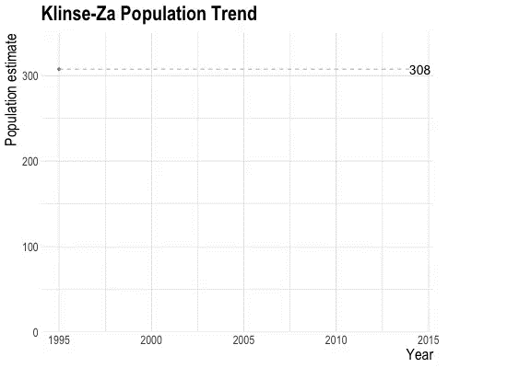
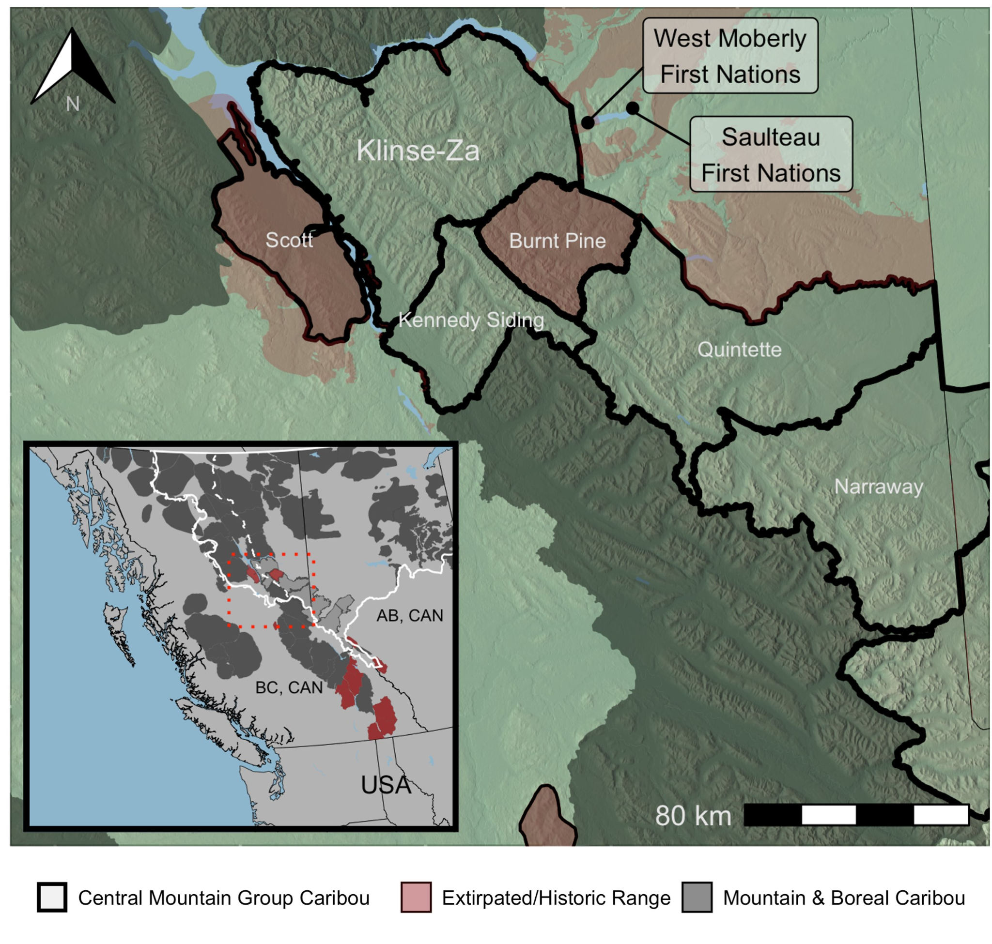
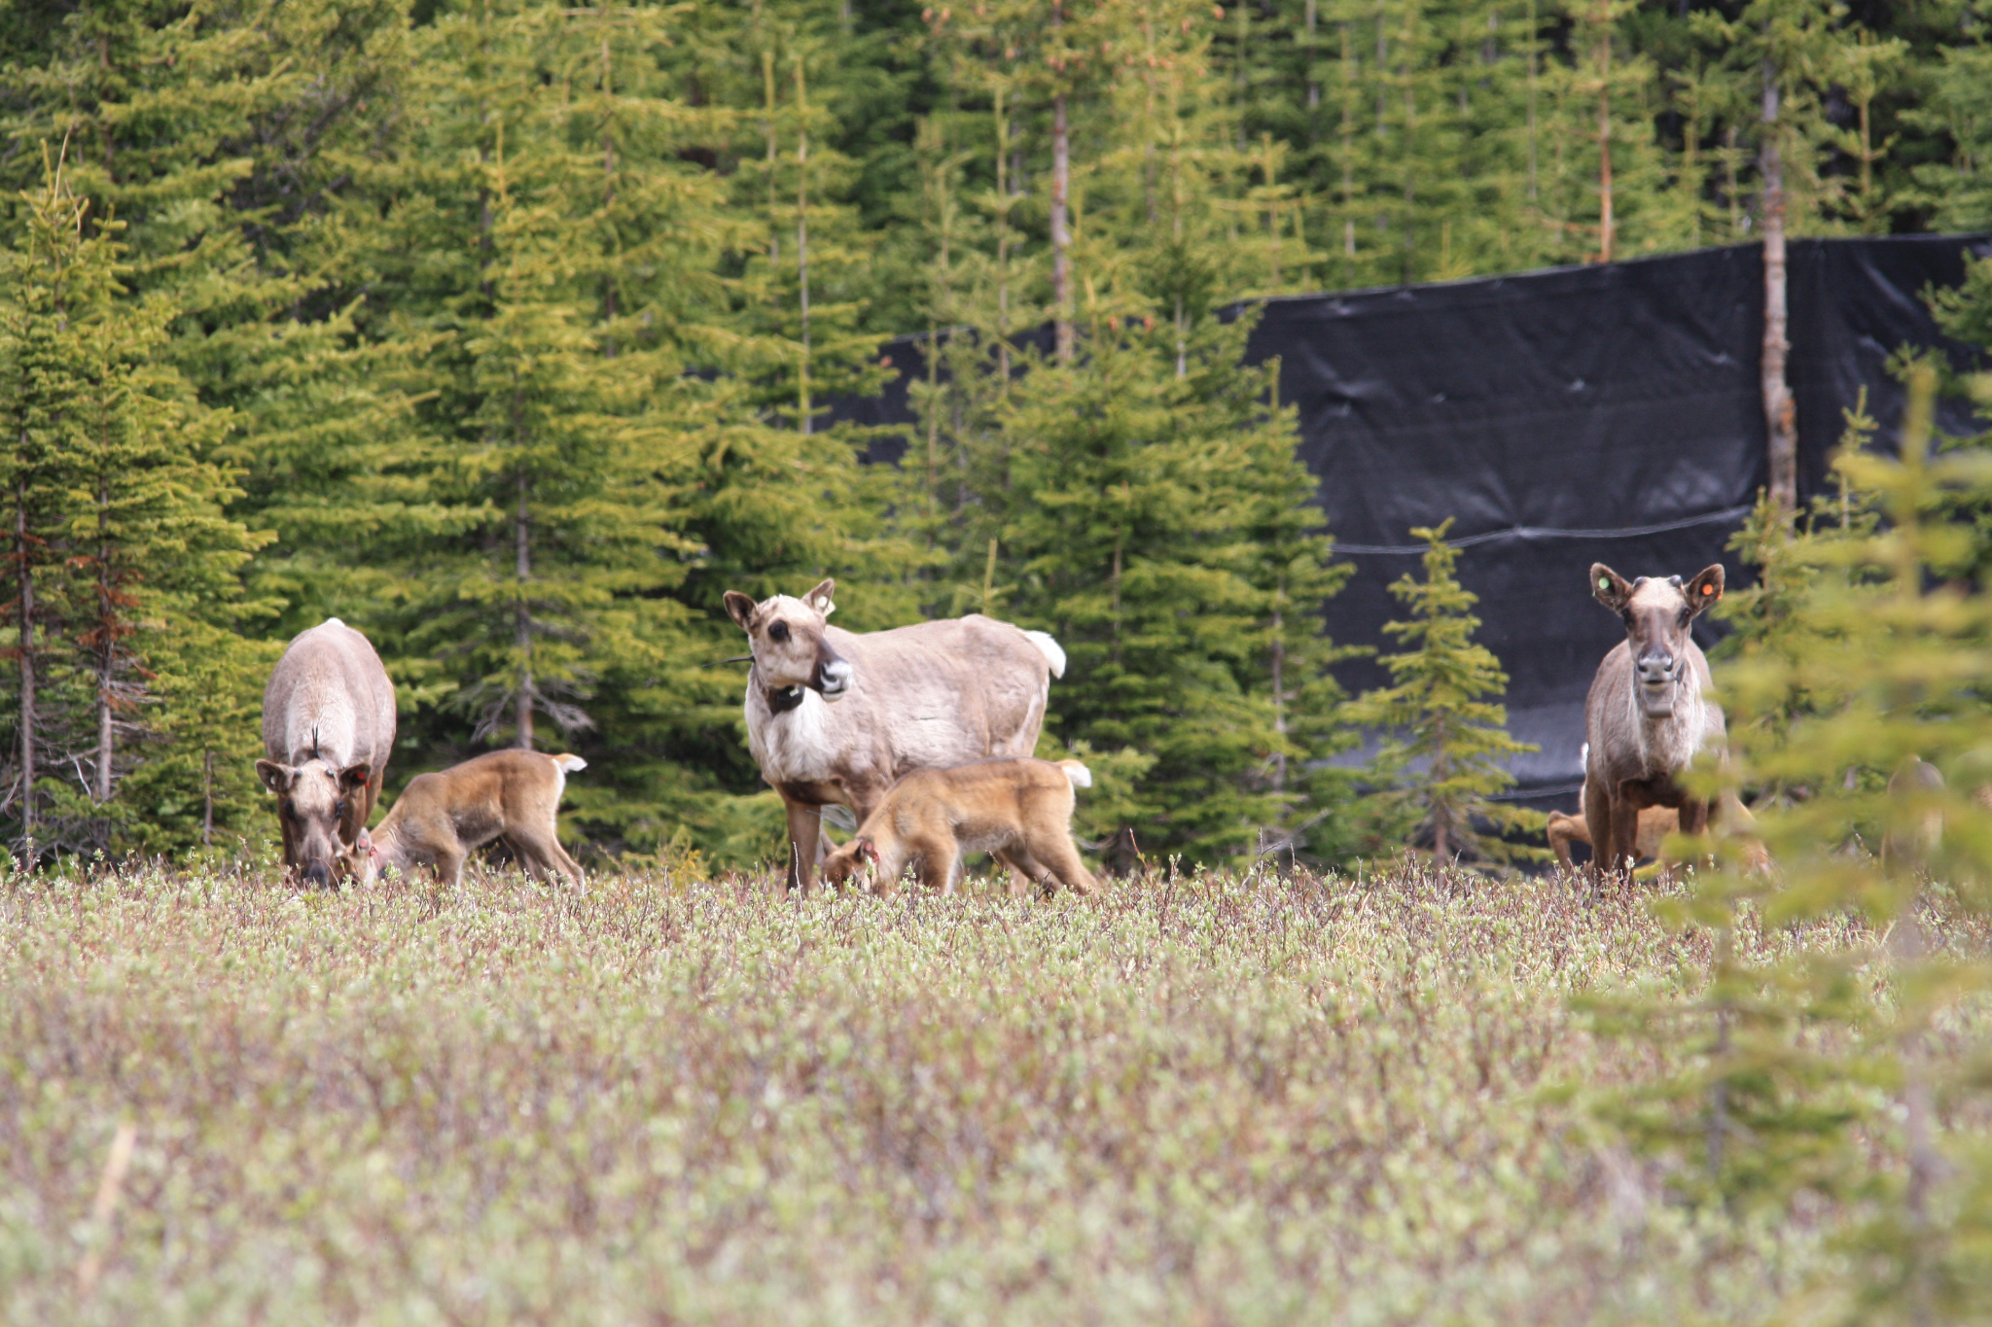
Klinse-Za mountain caribou
Lamb, C. T., R. Willson, C. Richter, N. Owens-Beek, J. Napoleon, B. Muir, R. S. McNay, E. Lavis, M. Hebblewhite, L. Giguere, T. Dokkie, S. Boutin, and A. T. Ford. 2022. Indigenous-led conservation: Pathways to recovery for the nearly extirpated Klinse-Za mountain caribou. Ecological Applications.
Notes:
Southern mtn caribou are endangered and could be lost in our generation
Rather than accept that fate, 2 First Nations began an ambitious recovery effort
The story of caribou is interwoven with indigenous peoples who have relied on caribou for subsistence and for ceremonial and cultural purposes since time immemorial
Caribou are fewer now - 12 herds have been lost in N. America since 2000… why?
Caribou evolved in habitats where they were the prominent large mamma
Today, resource extraction industry and climate change are changing predator-prey dynamics (among other things) for caribou
For this particular herd elevated wolf densities → increased mortality which was unsustainable for the population
Kinse-Za caribou herd in southern Canada - live in homelands of W Moberly First Nations and Salteau First Nations (Red is where they’re extirpated)
Used to be described by elders as abundant as “bugs on the landscape”
declined to only 38 by 2013!!!!!!!
However, the Nations and partners enacted emergency measures to avert total loss.

Slide 12
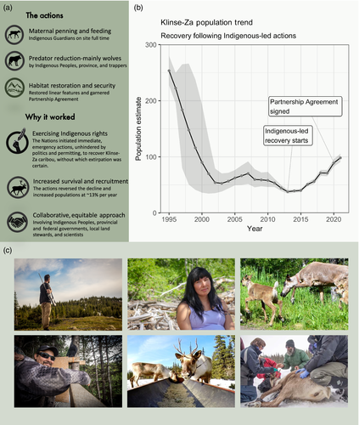
Notes:
Avert extirpation in the short term while creating a better future for caribou via long-term habitat solutions.
The short term=increasing caribou population growth by limiting predation via wolf density reductions (hunters and trappers along with the BC government reduced wolf density) and maternal penning. (bring adult caribou into maternity pens in late winter, calve in May/Jun, allow calves to growth ~8 weeks til they’re less vulnerable to predation, released in summer. Indigenous guardians look after bou in the pens
Also, doing habitat restoration
Indigenous-led recovery actions resulted in population growth - herd tripled in less than a decade to 114!
Takeaways - indigenous-led conservation mobilized collaboration - cultural AND ecological restoration

Slide 13
FINAL PRESENTATIONS - “What’s the deal with…”
Assigned into groups of 4-6 and a question/mystery
Rank your top 3 choices, or can create your own with a group
Interview
Biologist, manager, or other relevant party
Group Presentations (Dec. 6 & 8)
6-7 minutes, 3 minutes for questions
Everyone must speak
Individual write-up (Dec. 12)
2000-3500 words, 1.5 spacing, 12 pt font
8 peer-reviewed citations, 4 grey literature, interview

Slide 14
Timeline
Week of Nov 1: Ranking favorite topics + project assignment (TA’s)
Submit your ranking on Blackboard today
Thurs, Nov 10: Submit outline
Week of Nov 14: Schedule meetings to discuss outline & project with TA’s
Final presentations: Dec 6-8
Final write-up due: Dec 12 (reading day)

Slide 15
Reminders
Submit WRRB question before class Thurs
Outline due next Thurs 11/10
Quiz 2 Tues 11/15
Chloe gone next week, Riley substituting

Slide 16
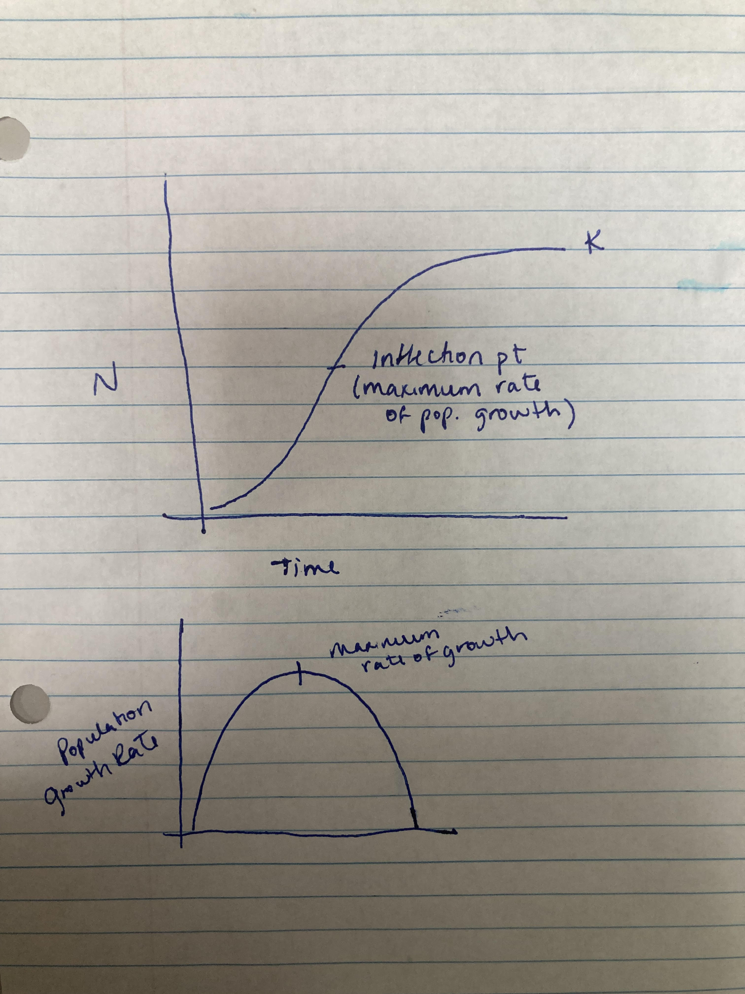
Last week review…

Slide 17
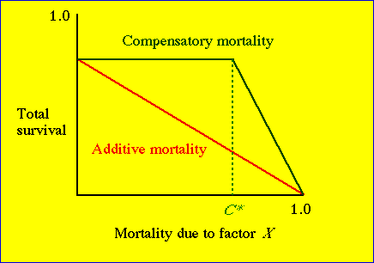
Compensatory vs additive mortality
If a given mortality factor (e.g. harvest, poisoning or predation) causes an immediate reduction in total survival, it is considered additive.
A compensatory factor, in contrast, causes no reduction in total survival (until it reaches some threshold value, C*).
http://www.uwyo.edu/dbmcd/popecol/aprlects/lect27.html#:~:text=If%20a%20given%20mortality%20factor,some%20threshold%20value%2C%20C*).

